Slide 1
20190121
THz EPR
Lee Jong Geon

Slide 2
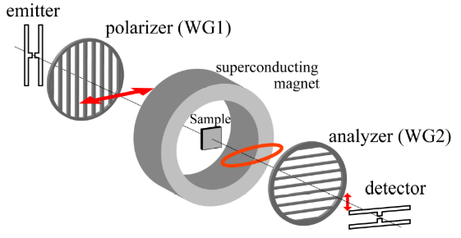
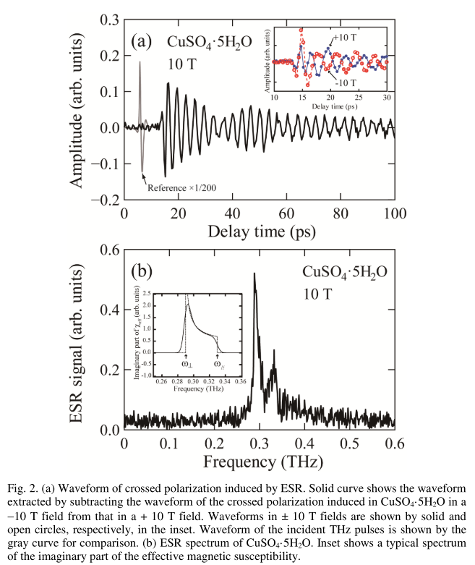
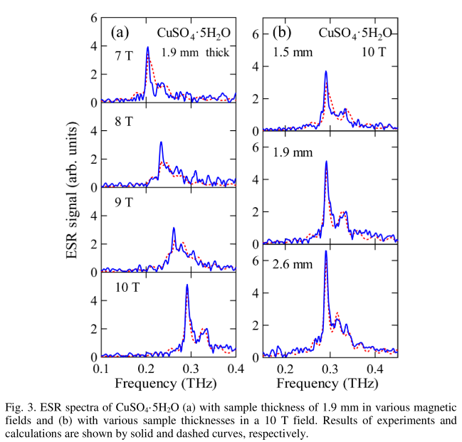
2011-Optics Express-19,25-Measurement of electron paramagnetic resonance using terahertz time-domain spectroscopy (Kohei Kozuki, Takeshi Nagashima, Masanori Hangyo)
Wire grids (wire diameter=5 µm, spacing=12.5 µm, cutoff frequency=~6 THz
A ± 10 T superconducting magnet
PC antennas, pulse (780 nm, 98 fs, 50 MHz, 12mW)
Sample: Copper(II) sulfate pentahydrate (CuSO₄∙5H₂O)
Powder pressed to disk(diameter=13 mm, thickness=~2 mm, mass=566 mg)
50 average, room temperature

Slide 3
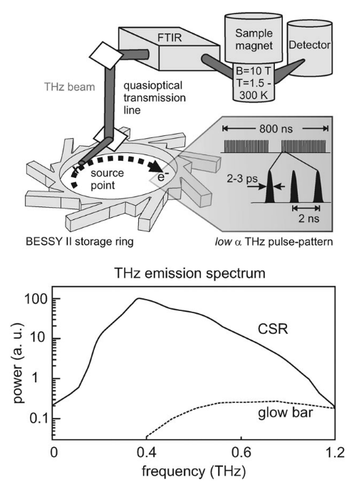
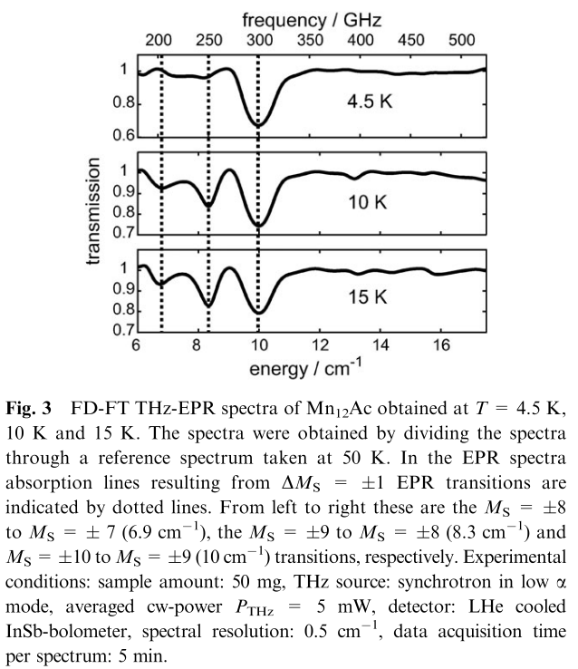
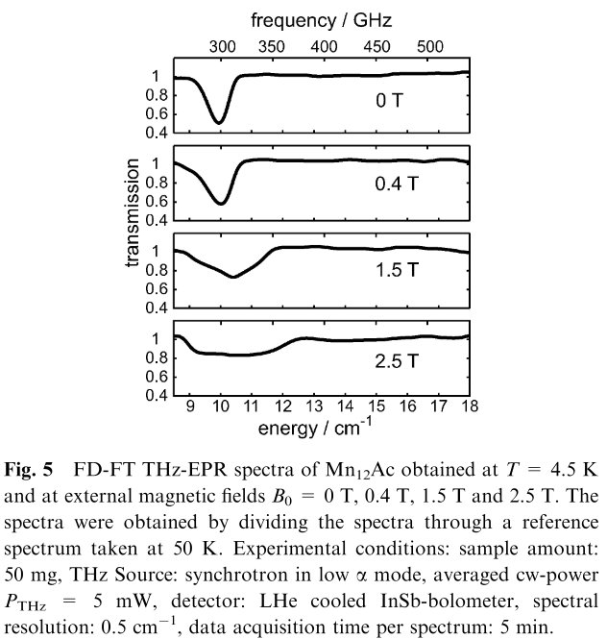
2009-Physical Chemistry Chemical Physics-11,31-Frequency domain Fourier transform THz-EPR on single molecule magnets using coherent synchrotron radiation (Alexander Schnegg, Jan Behrends, Klaus Lips, Robert Bittl, Karsten Holdack)
Liquid helium-cooled cryostat(T=1.5-300 K)
A ±10 T superconducting magnet
FTIR-spectrometer(Bruker Verex 70, min. bandwidth: 0.5 cm⁻¹)
Detection: liquid helium-cooled InSb and Si bolometers
Sample: Mn₁₂O₁₂(CH₃COO)₁₆(H₂O)₄ (Mn₁₂Ac)

Slide 4
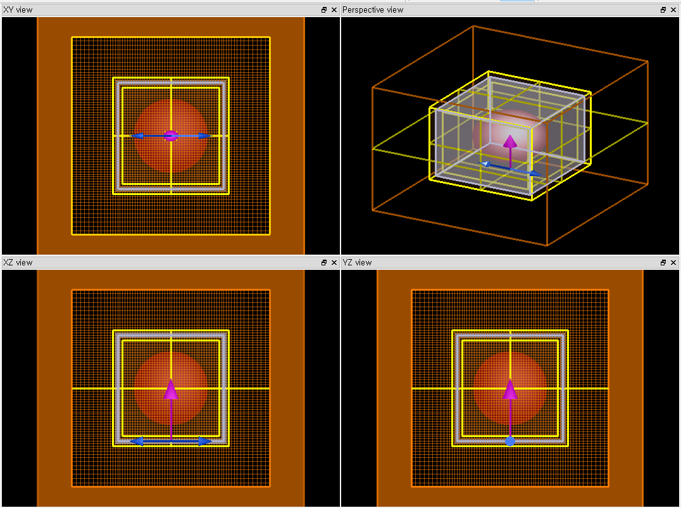
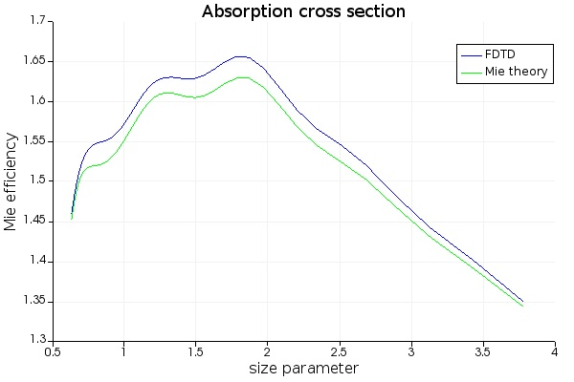
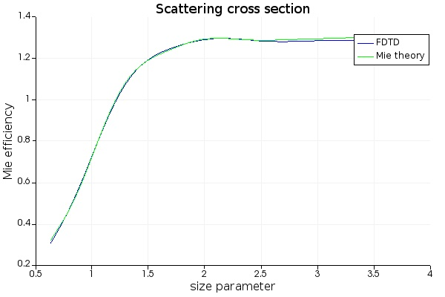
Mie Scattering
Sphere radius = 150 μm
Material: VeroClear (3D printer)
Source: 0.2-1.2 THz z-axis
2013-ACM Trans. Graph.-32,4,Article 138-InfraStructure:Fabricating Information Inaide Physical Objetcts for Imaging in the Terahertz Region (Karl D.D. Willis, Andrew D. Wilson)
Re(n)
Im(n)

